Slide 1


Machine Learning using Python
ಡಾ|| ತ್ಯಾಗರಾಜು ಜಿ.ಎಸ್
Head Dept of CSE
SDMIT Ujire

Slide 2
Agenda
Machine Learning Engineering - Introduction
Python Fundamentals – Hands On
Decision Tree Learning
Machine Learning Lab Problems and Programs

Slide 3
Machine Learning Engineering
ಡಾ|| ತ್ಯಾಗರಾಜು ಜಿ.ಎಸ್
Head Dept of CSE
SDMIT Ujire

Slide 4
Contents
What is Machine Learning ?
Machine Learning Engineer
Skills required to become MLE
Architecture of Machine Learning
Machine Learning Algorithms - Types
Machine Learning Tools
Open Source and Commercial Machine Learning Tools
Introduction to Scikit Learn
Deep Learning

Slide 5
1. What is Machine Learning ?
Study of algorithms that
Improve their performance P
At some task T
With Experience E
Well-defined learning task<P,T,E>
Machine learning (ML) — a subset of artificial intelligence (AI) — is more than a technique for analyzing data. It's a system that is fueled by data, with the ability to learn and improve by using algorithms that provide new insights without being explicitly programmed to do so.

Slide 6
Figure 1. Learning From Data Without Being Explicitly Programmed

Slide 7
Figure 2. Stages of the Machine Learning Process

Slide 8
2. Machine Learning Engineer
Machine learning engineers are sophisticated programmers who develop machines and systems that can learn and apply knowledge without specific direction.
The algorithms they create allow a machine to find patterns in its own programming data, teaching it to understand commands and even think for itself.
Example : An example of a system a machine learning engineer would work on is a self-driving car and automatic vacuum cleaner.

Slide 9
3. Skills required for MLE
Math Skills
Programming Skills
Data Engineering Skills
Knowledge of Machine Learning Algorithms
Knowledge of Machine Learning Frameworks
Knowledge of IoT and Cloud Computing
Excellent Communication Skills

Slide 10
3.1. Math Skills
Probability and Statistics : Descriptive Statistics , Bayes Rule and Random Variables , Probability Distributions , Sampling Hypothesis , Testing Regression and Decision Analysis.
Linear Algebra : Matrices , Vector Spaces
Calculus : Basics of Differential and Integral calculus

Slide 11
3.2. Programming Skills
Coding Skills , Algorithms , Data Structure and OOPS Concepts
Languages like Python , R , Java and C (Master of any one or two)

Slide 12
3.3. Data Engineering Skills
Ability to work with large amount of Data , Data Preprocessing , Knowledge of SQL an No SQL .
ETL (Extract , Transform and Load ) Operations
Data Analysis and Visualization Skills

Slide 13
3.4. Knowledge of Machine Learning Algorithms
Shallow and Deep Learning
Supervised
Unsupervised
Semi Supervised
Reinforcement

Slide 14
3.5. Knowledge of Machine Learning Frameworks
Familiar with popular machine learning Frameworks such as
SCIKIT Learn,
TensorFlow ,
Azure ,
Caffe ,
Theano,
Spark and
Torch

Slide 15
4.Machine Learning Architecture

Slide 16
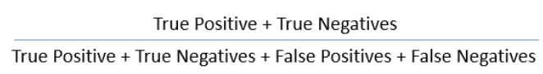
Terms Frequently Used
Accuracy : Accuracy is a metric by which one can examine how good is the machine learning model.
Backpropagation: In neural networks, if the estimated output is far away from the actual output (high error), we update the biases and weights based on the error. This weight and bias updating process is known as Back Propagation. Back-propagation (BP) algorithms work by determining the loss (or error) at the output and then propagating it back into the network. The weights are updated to minimize the error resulting from each neuron. The first step in minimizing the error is to determine the gradient (Derivatives) of each node w.r.t. the final output.

Slide 17
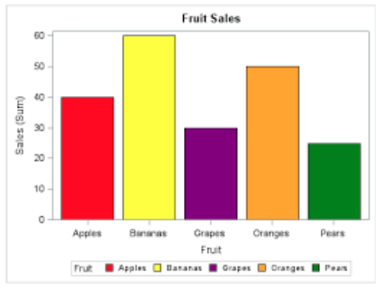
Terms Frequently Used
Bar Chart : Bar charts are a type of graph that are used to display and compare the numbers, frequency or other measures (e.g. mean) for different discrete categories of data. They are used for categorical variables. Simple example of a bar chart:

Slide 18
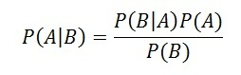
Terms Frequently Used
Bayes Theorem : Bayes’ theorem is used to calculate the conditional probability. Conditional probability is the probability of an event ‘B’ occurring given the related event ‘A’ has already occurred.
Boosting : Boosting is a sequential process, where each subsequent model attempts to correct the errors of the previous model. The succeeding models are dependent on the previous model. Some of the boosting algorithms are:
AdaBoost
GBM
XGBM
LightGBM
CatBoost

Slide 19
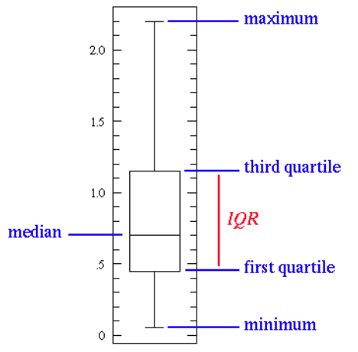
Terms Frequently Used
Box Plot : It displays the full range of variation (from min to max), the likely range of variation (the Interquartile range), and a typical value (the median). Below is a visualization of a box plot:
Some of the inferences that can be made from a box plot:
Median: Middle quartile marks the median.
Middle box represents the 50% of the data
First quartile: 25% of data falls below these line
Third quartile: 75% of data falls below these line.

Slide 20
Terms Frequently Used
Classification: The goal is to predict discrete values, e.g. {1,0}, {True, False}, {spam, not spam}. It is supervised learning method where the output variable is a category, such as “Male” or “Female” or “Yes” and “No”.
For example: Classification Algorithms like Logistic Regression, Decision Tree, K-NN, SVM etc.
Clustering : Clustering is an unsupervised learning method used to discover the inherent groupings in the data. For example: Grouping customers on the basis of their purchasing behaviour which is further used to segment the customers. And then the companies can use the appropriate marketing tactics to generate more profits.
Example of clustering algorithms: K-Means, hierarchical clustering, etc.

Slide 21
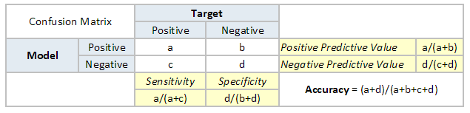
Terms Frequently Used
Confusion Matrix :A confusion matrix is a table that is often used to describe the performance of a classification model. It is a N * N matrix, where N is the number of classes. We form confusion matrix between prediction of model classes Vs actual classes. The 2nd quadrant is called type II error or False Negatives, whereas 3rd quadrant is called type I error or False positives.

Slide 22
Terms Frequently Used
Continuous Variable : Continuous variables are those variables which can have infinite number of values but only in a specific range. For example, height is a continuous variable.
Convergence :Convergence refers to moving towards union or uniformity. An iterative algorithm is said to converge when as the iterations proceed the output gets closer and closer to a specific value.
Cross Validation: Cross Validation is a technique which involves reserving a particular sample of a dataset which is not used to train the model. Later, the model is tested on this sample to evaluate the performance. There are various methods of performing cross validation such as:
Leave one out cross validation (LOOCV)
k-fold cross validation
Stratified k-fold cross validation
Adversarial validation

Slide 23
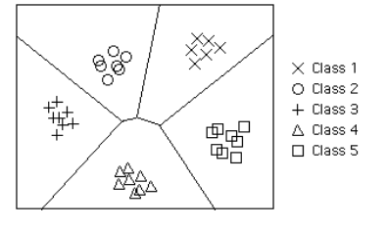
Terms Frequently Used
Decision Boundary : In a statistical-classification problem with two or more classes, a decision boundary or decision surface is a hypersurface that partitions the underlying vector space into two or more sets, one for each class. How well the classifier works depends upon how closely the input patterns to be classified resemble the decision boundary. In the example sketched below, the correspondence is very close, and one can anticipate excellent performance.
Here the lines separating each class are decision boundaries.

Slide 24
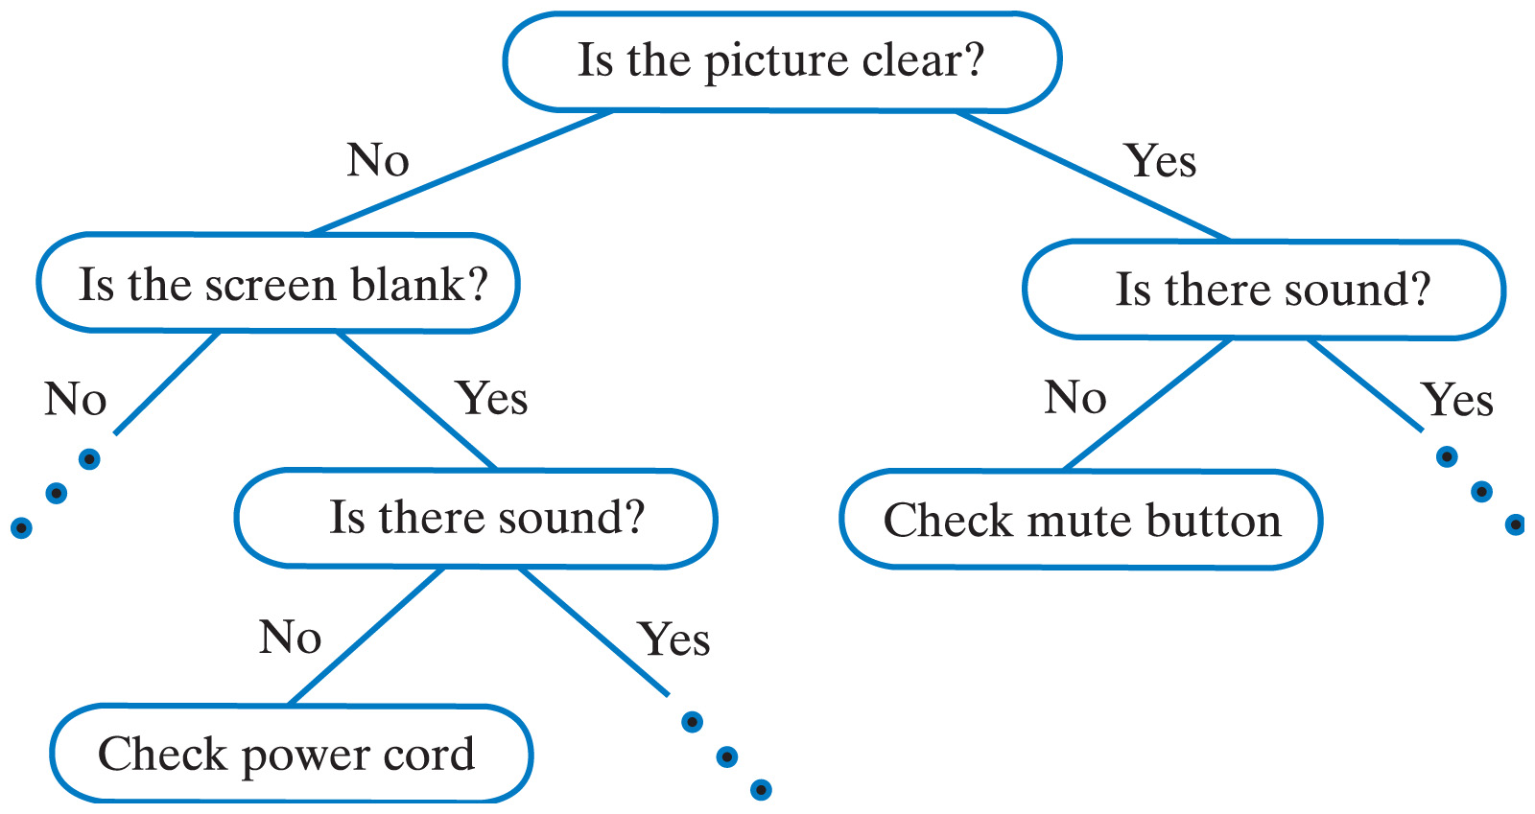
Terms Frequently Used
Decision Tree : Decision tree is a type of supervised learning algorithm (having a pre-defined target variable) that is mostly used in classification problems. It works for both categorical and continuous input & output variables. In this technique, we split the population (or sample) into two or more homogeneous sets (or sub-populations) based on most significant splitter / differentiator in input variables.

Slide 25
Terms Frequently Used
Deep Learning : Deep Learning is associated with a machine learning algorithm (Artificial Neural Network, ANN) which uses the concept of human brain to facilitate the modeling of arbitrary functions. ANN requires a vast amount of data and this algorithm is highly flexible when it comes to model multiple outputs simultaneously.
Dependent Variable : A dependent variable is what you measure and which is affected by independent / input variable(s). It is called dependent because it “depends” on the independent variable. For example, let’s say we want to predict the smoking habits of people. Then the person smokes “yes” or “no” is the dependent variable.
False Negative : Points which are actually true but are incorrectly predicted as false. For example, if the problem is to predict the loan status. (Y-loan approved, N-loan not approved). False negative in this case will be the samples for which loan was approved but the model predicted the status as not approved.
False Positive: Points which are actually false but are incorrectly predicted as true. For example, if the problem is to predict the loan status. (Y-loan approved, N-loan not approved). False positive in this case will be the samples for which loan was not approved but the model predicted the status as approved.

Slide 26
Terms Frequently Used
Gradient Descent: Gradient descent is a first-order iterative optimization algorithm for finding the minimum of a function. In machine learning algorithms, we use gradient descent to minimize the cost function. It find out the best set of parameters for our algorithm. Gradient Descent can be classified as follows:
On the basis of data ingestion:
Full Batch Gradient Descent Algorithm
Stochastic Gradient Descent Algorithm
In full batch gradient descent algorithms, we use whole data at once to compute the gradient, whereas in stochastic we take a sample while computing the gradient.
On the basis of differentiation techniques:
First order Differentiation
Second order Differentiation

Slide 27
Terms Frequently Used
Hypothesis : Simply put, a hypothesis is a possible view or assertion of an analyst about the problem he or she is working upon. It may be true or may not be true
Labeled Data: Data consisting of a set of training examples, where each example is a pair consisting of an input and a desired output value (also called the supervisory signal, labels, etc). A label is the thing we're predicting—the y variable in simple linear regression. The label could be the future price of wheat, the kind of animal shown in a picture, the meaning of an audio clip, or just about anything.
Maximum Likelihood Estimation : It is a method for finding the values of parameters which make the likelihood maximum. The resulting values are called maximum likelihood estimates (MLE).
Multivariate Analysis : Multivariate analysis is a process of comparing and analyzing the dependency of multiple variables over each other.

Slide 28
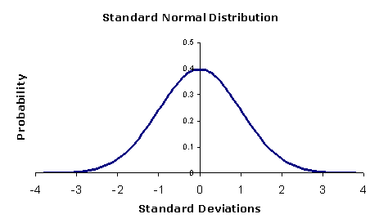
Terms Frequently Used
Naive Bayes : It is a classification technique based on Bayes’ theorem with an assumption of independence between predictors. In simple terms, a Naive Bayes classifier assumes that the presence of a particular feature in a class is unrelated to the presence of any other feature. For example, a fruit may be considered to be an apple if it is red, round and about 3 inches in diameter. Even if these features depend on each other or upon the existence of the other features, a naive Bayes classifier would consider all of these properties to independently contribute to the probability that this fruit is an apple.
Normal Distribution : The normal distribution is the most important and most widely used distribution in statistics. It is sometimes called the bell curve, because it has a peculiar shape of a bell. Mostly, a binomial distribution is similar to normal distribution. The difference between the two is normal distribution is continuous.

Slide 29
Terms Frequently Used
Normalization : Normalization is the process of rescaling your data so that they have the same scale. Normalization is used when the attributes in our data have varying scales.
For example, if you have a variable ranging from 0 to 1 and other from 0 to 1000, you can normalize the variable, such that both are in the range 0 to 1.
Overfitting : A model is said to overfit when it performs well on the train dataset but fails on the test set. This happens when the model is too sensitive and captures random patterns which are present only in the training dataset. There are two methods to overcome overfitting:
Reduce the model complexity
Regularization

Slide 30
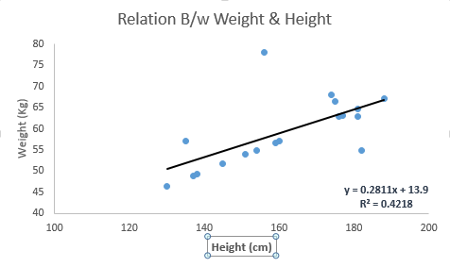
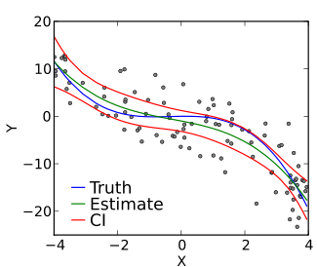
Terms Frequently Used
Regression: It is supervised learning method where the output variable is a real value, such as “amount” or “weight”.
Example of Regression: Linear Regression, Ridge Regression, Lasso Regression
Linear Regression : is a method for finding the straight line or hyperplane that best fits a set of points. Y=aX+b , where:
Y – Dependent Variable
a – Slope
X – Independent variable
b – Intercept
Polynomial Regression :In this technique, a curve fits into the data points. In a polynomial regression equation, the power of the independent variable is greater than 1. Although higher degree polynomials give lower error, they might also result in over-fitting.

Slide 31
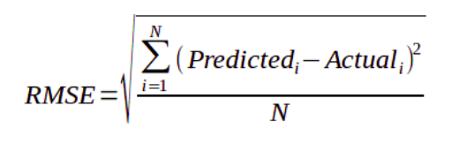
Terms Frequently Used
Root Mean Squared Error (RMSE):RMSE is a measure of the differences between values predicted by a model or an estimator and the values actually observed. It is the standard deviation of the residuals. Residuals are a measure of how far from the regression line data points are. The formula for RMSE is given by:
Here,
Predicted -> value predicted by the model
Actual -> observed values
N -> Total number of observations

Slide 32
Terms Frequently Used
Underfitting: Underfitting occurs when a statistical model or machine learning algorithm cannot capture the underlying trend of the data. It refers to a model that can neither model on the training data nor generalize to new data. An underfit model is not a suitable model as it will have poor performance on the training data.
Univariate Analysis : Univariate analysis is comparing and analyzing the dependency of a single predictor and a response variable
True Negative : These are the points which are actually false and we have predicted them false.
True Positive : These are the points which are actually true and we have predicted them true.

Slide 33
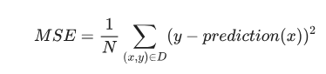
Terms Frequently Used
Model: A model defines the relationship between features and label. For example, a spam detection model might associate certain features strongly with "spam".
Training means creating or learning the model. That is, you show the model labeled examples and enable the model to gradually learn the relationships between features and label
Loss : Loss for a given example is also called squared error .
= Square of the difference between prediction and label
= (observation - prediction)²
= (y - y’)²
Mean square error (MSE) is the average squared loss per example over the whole dataset. To calculate MSE, sum up all the squared losses for individual examples and then divide by the number of examples:

Slide 34
5. Types of Machine Learning Algorithms
Based on Depth of Learning
Based on Type of learning

Slide 35
5.1 Based on Depth of Learning
Shallow Learning
Algorithms with Few Layers
Better for Less Complex and Smaller Data sets
Eg: Logistic Regression and Support vector Machines
Deep Learning
New technique that uses many layers of neural network ( a model based on the structure of human brain)
Useful when the target function is very complex and data sets are very large.

Slide 36
5.2 Based on Type of Learning
Supervised Learning
X and Y
Given an observation X what is the best label for Y
Unsupervised Learning
X
Given a set of X cluster or summarize them
Semi Supervised Learning
Reinforcement Learning
Determine what to do based on Rewards and punishments

Slide 37
5.2.1. Supervised Learning
Here the training (labeled) data set containing input/predictors and output will be fed to the machine. The machine with the help of algorithm analyze the data set and generates a suitable model /function that best describes the input data. i.e it generates a function f(X) which makes best estimation of the output X for given X.
The generated model / function can be used to predict the output values for new data based on those relationships which it learned from the previous data sets.
When Y is discrete (True /False, ..) – Classification
When X is continuous (Real Numbers )- Regression

Slide 38
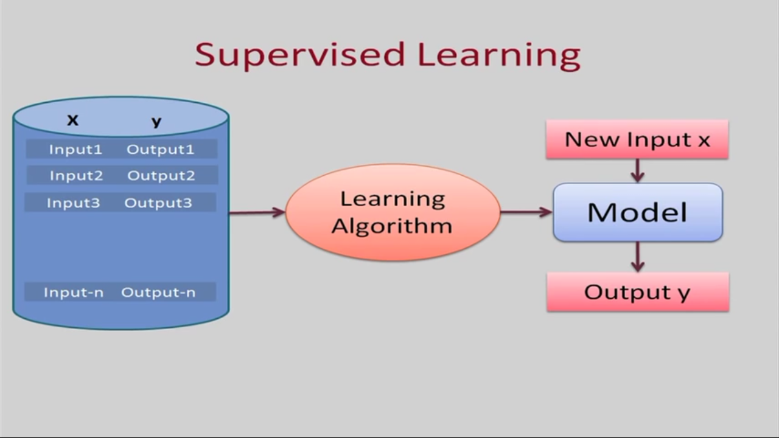

Slide 39
Types of Supervised Learning (Task Driven . Develop Prediction Model based on Input and Output Data)
Classification ( Discrete)
Logistic Regression
KNN
Decision Trees
Support Vector Machines
Naïve Bayesian
Discriminant Analysis
Random Forest
AdaBoost
Neural Networks
Regression ( Continuous)
Linear Regression
SVR
GPR
Ensemble Methods

Slide 40
5.2.2: Unsupervised Learning
This approach is data driven . The computer is trained with unlabeled input data.
These algorithms try to use techniques on the input data to mine for rules, detect patterns, and summarize and group the data points which help in deriving meaningful insights and describe the data better to the users.

Slide 41
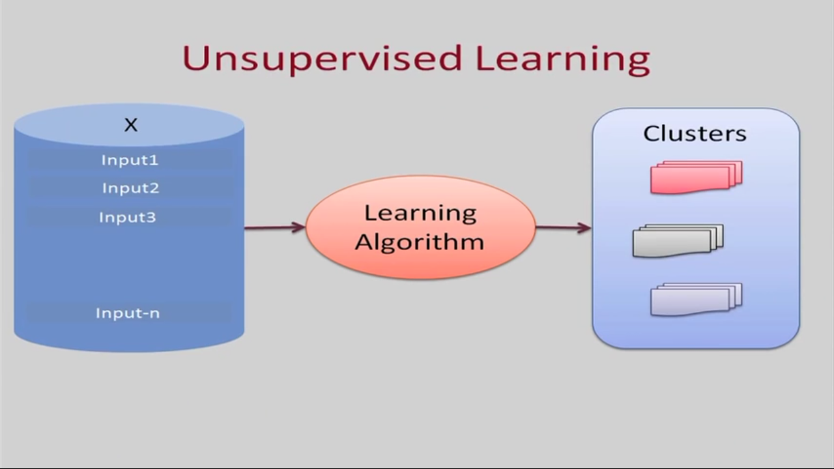

Slide 42
Types of Unsupervised Learning
Clustering
K Means Clustering
Hierarchical Clustering
Gaussian Mixture Models
Genetic Algorithms
Artificial Neural Networks
Dimensionality Reduction
Tensor Decomposition
Principal Component Analysis
Multidimensional statistics
Random Projection
Artificial Neural Networks
Association Rules

Slide 43
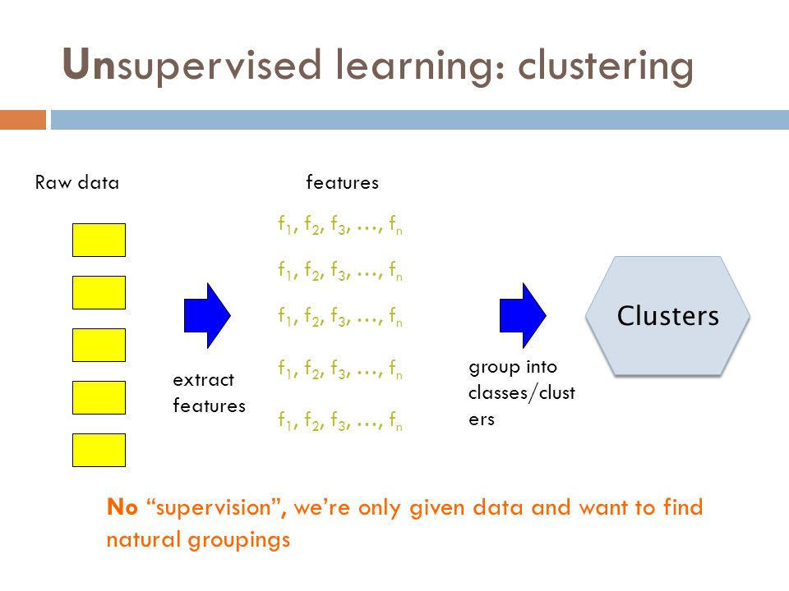

Slide 44
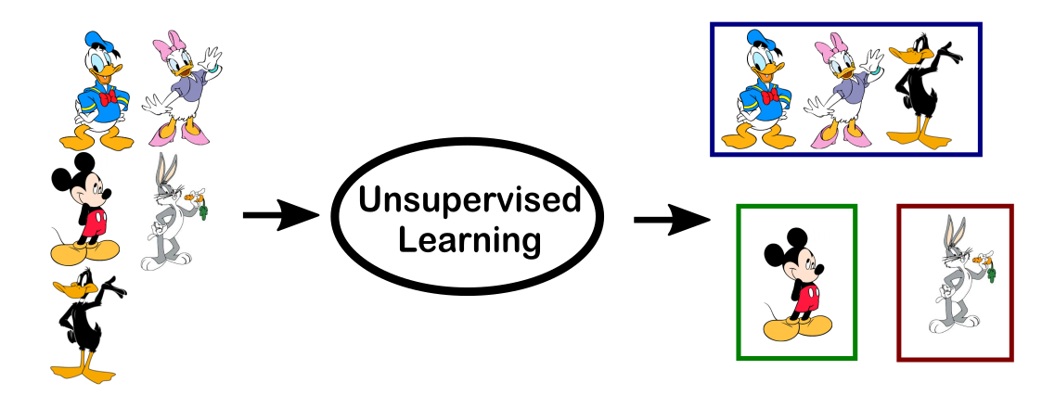

Slide 45
5.2.3. Semi Supervised
In the previous two types, either there are no labels for all the observation in the dataset or labels are present for all the observations.
Semi-supervised learning falls in between these two.

Slide 46
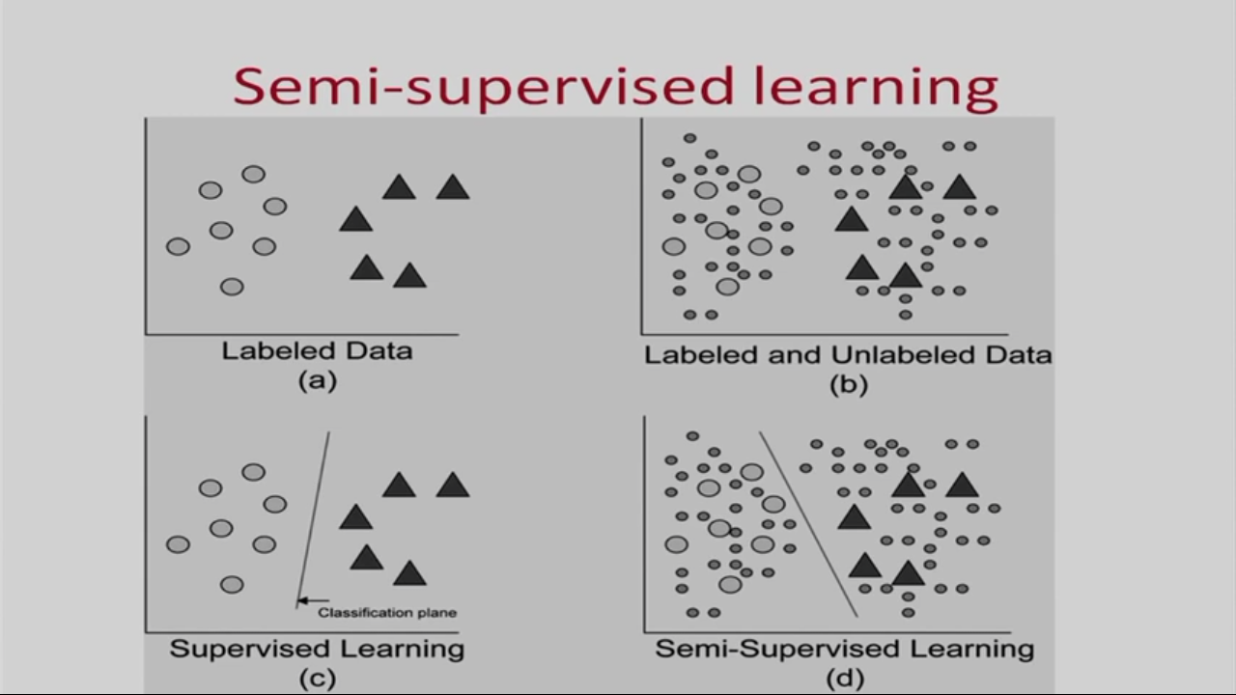

Slide 47
5.2.4. Reinforcement Learning
This method aims at using observations gathered from the interaction with the environment to take actions that would maximize the reward or minimize the risk.
Reinforcement learning algorithm (called the agent) continuously learns from the environment in an iterative fashion.

Slide 48
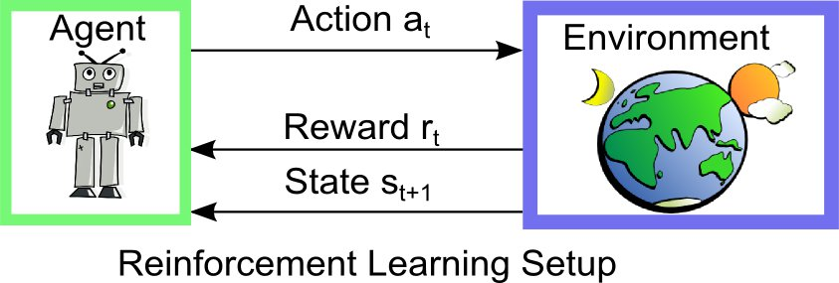

Slide 49
Types of Reinforcement Learning Algorithms
Q-Learning
Temporal Difference (TD)
Deep Adversarial Networks

Slide 50
Table1: Examples of Types of Machine Learning Algorithms / Problem Solving Approaches
Type | Model /Algorithm or Task | Usage Examples in Business
Supervised | Neural network | ■ Predicting financial results ■ Fraud detection
Supervised | Classification and/or Regression | ■ Spam filtering ■ Fraud detection
Supervised | Decision tree | ■ Risk assessment ■ Threat management systems ■ Any optimization problem where an exhaustive search is not feasible

Slide 51
Table1: Examples of Types of Machine Learning Algorithms / Problem Solving Approaches
Type | Model /Algorithm or Task | Usage Examples in Business
Unsupervised | Cluster analysis | ■ Financial transactions ■ Streaming analytics in IoT ■ Underwriting in insurance
Unsupervised | Pattern recognition | ■ Spam detection ■ Biometrics ■ Identity management
Unsupervised | Association rule learning | ■ Security and intrusion detection ■ Bioinformatics ■Manufacturing and Assembly

Slide 52
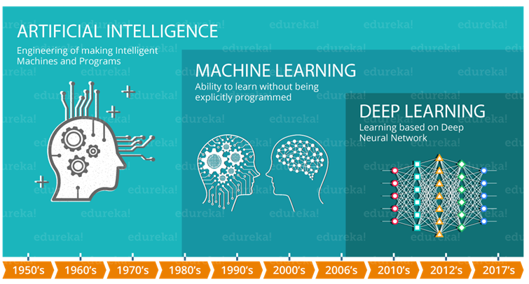

Slide 53
6. Open Source and Commercial Tools

Slide 54
Open Source Tools
OpenAI
TensorFlow
Keras
Charnn
Paddle
CNTK
R
Monte Carlo ML Library
Octave Forge
Scikit Learn
Shogun
Accord.NET Framework
Spark MLlib
H20
Coudera Oryx
GoLearn
Weka
Deep Learn.js
ConvNet.Js

Slide 55
Commercial Tools
Microsoft Azure Machine Learning
SAS Enterprise Miner
IBM SPSS Modeler
RapidMiner
Apache Mahout
MATLAB
Oracle Data Mining

Slide 56
7. Introduction to Scikit Learn – A Python Machine Learning Library

Slide 57
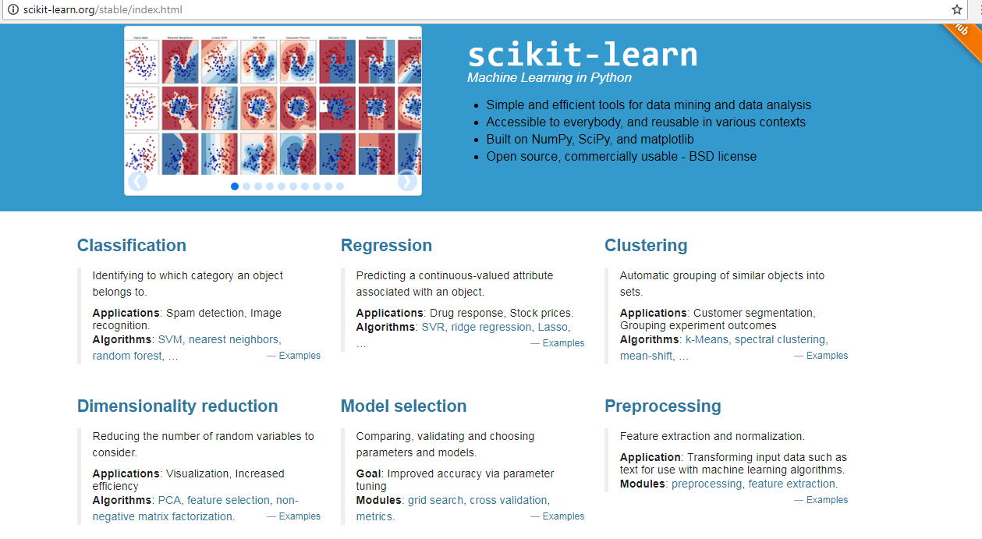
Scikit Learn : http://scikit-learn.org/stable/index.html

Slide 58
What is scikit-learn?
Scikit-learn provides a range of supervised and unsupervised learning algorithms via a consistent interface in Python.
It is licensed under a permissive simplified BSD license and is distributed under many Linux distributions, encouraging academic and commercial use.
The library is built upon the SciPy (Scientific Python) that must be installed before you can use scikit-learn.

Slide 59
Example : Scikit learn Machine Learning
There are 5 key libraries that you will need to install. Below is a list of the Python SciPy libraries required for this tutorial:
scipy
numpy
matplotlib
pandas
sklearn

Slide 60
8. Introduction to Deep Learning
Deep learning is a type of machine learning that is based on algorithms with extensive connections or layers between inputs and outputs.
ML neural nets have inputs (variables), hidden layers (functions that compute the output) and output (results).
In a simple example, imagine an ML neural net to detect a dog. This seemingly simple example may include a tail detector, ear detector, hair detector and so on.
These detectors are combined into layers that contribute to detecting a dog. The more "detectors" you have, the deeper the neural net.

Slide 61
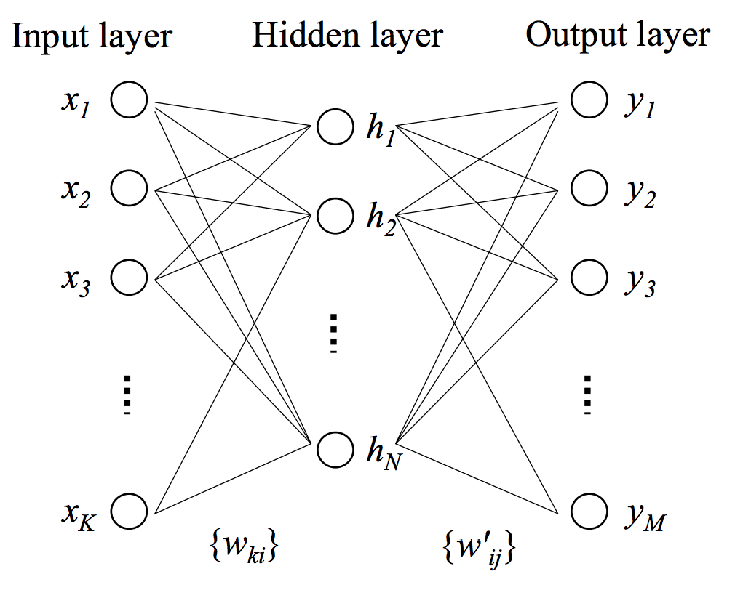
Deep Learning

Slide 62
Deep Learning Tools
Neural Designer
Torch
Apache SINGA
Microsoft Cognitive ToolKit
Keras
Deeplearning4j
Theano
MXNet
H2O.ai
ConvNetjs
DeepLEarningkit
Gensim
Caffe
ND4J
DeepLearnToolBox

Slide 63
2.Python Fundamentals

Slide 64
Python Introduction
Python is a general-purpose interpreted, interactive, object-oriented, and high-level programming language.
It was created by Guido van Rossum during 1985- 1990.
Python is named after a TV Show called ‘Monty Python’s Flying Circus’ and not after Python-the snake.

Slide 65
Features of Python
High-level Language and Simple
Free and Open Source
Portable
Interactive and Interpreted
Object Oriented
Scalable
Embeddable
Extensive Libraries
Database Support
Programming GUI/APP

Slide 66
Programming Editors
Python 3.6 Command Prompt
Python 3.6 Idle
Anaconda Prompt
Anaconda Jupyter Notebook
Anaconda Spider
JetBrains PyCharm

Slide 67
Python 3.6

Slide 68

Python3.6 Installation
Go to web page : https://www.python.org/downloads/

Slide 69


Slide 70
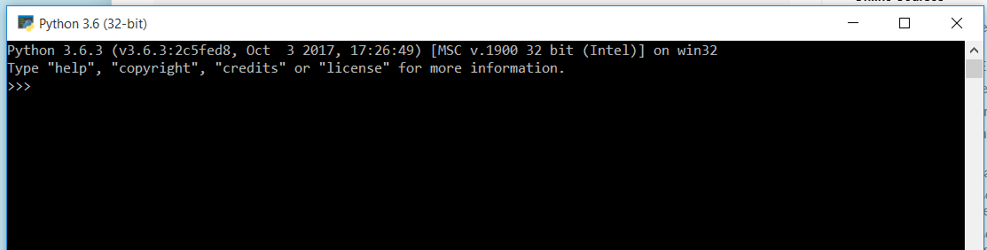
Interactive Python Programming

Slide 71
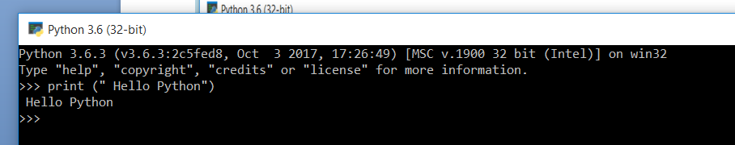

Slide 72
What is Anaconda?
The open source Anaconda Distribution is the easiest way to do Python data science and machine learning.
It includes hundreds of popular data science packages and the conda package and virtual environment manager for Windows, Linux, and MacOS.

Slide 73
Use Python for…
Web Development: Django, Pyramid, Bottle, Tornado, Flask, web2py
GUI Development: tkInter, PyGObject, PyQt, PySide, Kivy, wxPython
Scientific and Numeric: SciPy, Pandas, IPython
Software Development: Buildbot, Trac, Roundup
System Administration: Ansible, Salt, OpenStack

Slide 74
Some Python Packages/Libraries
Tornado
Web2py
Json
tKinter
OpenCV
PyGObject
PyQt
wxPython
Kivy
Buildozer
Buildbot
Trac
Roundup
Ansible
Salt
OpenStack
Keras
Tensor Flow
Theano
nltk
Spacy
TextBlog
ScikitLearn
Pattern
SQLalchemy
pyMySql
Numpy
Scipy
Pandas
Matplotlib
Seaborn
Bokeh
Scikit Learn
Pygames
dJango
Flask
Bottle
Pyramid
PyBrain
PyMongo

Slide 75

Downloading Anaconda
The latest version of Anaconda is available for download from https://www.anaconda.com/download/

Slide 76


Slide 77
JUPYTER NOTEBOOK

Slide 78
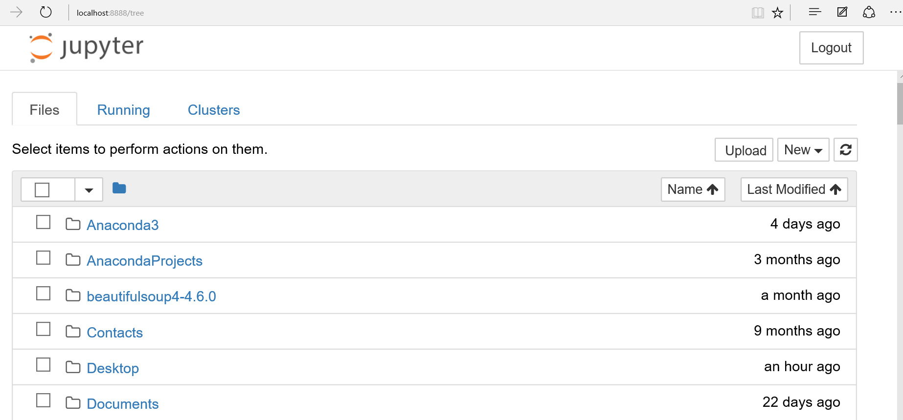

Slide 79
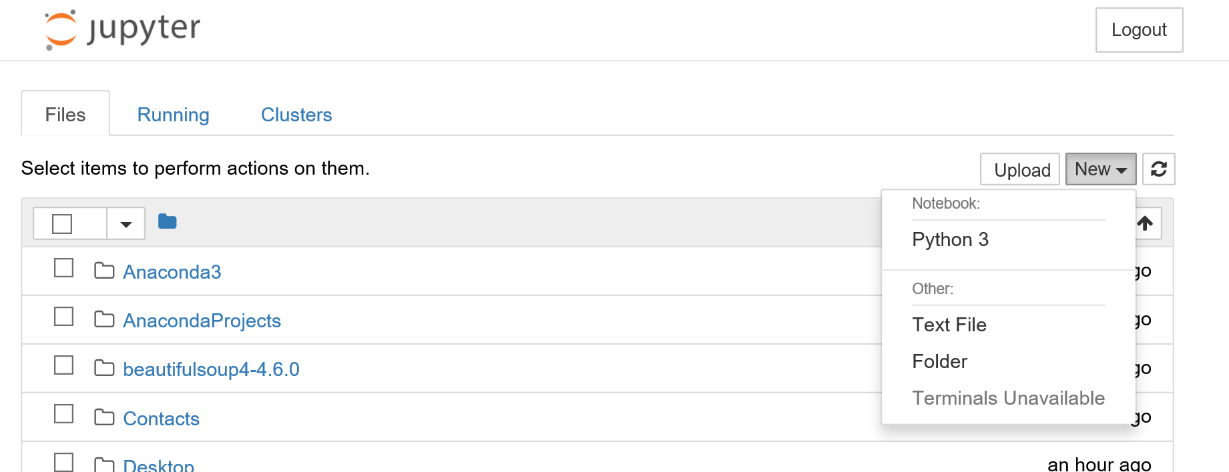

Slide 80
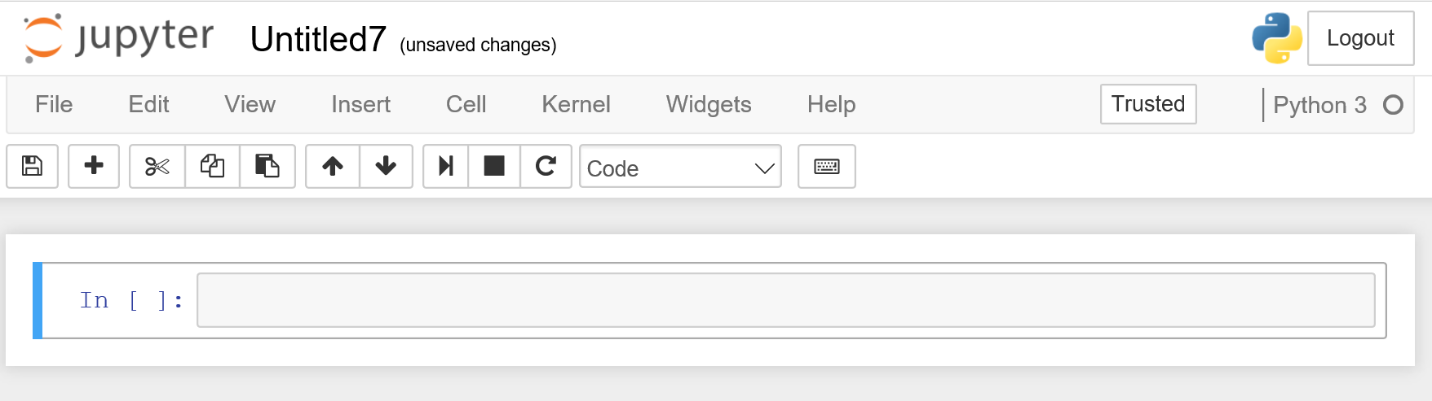

Slide 81
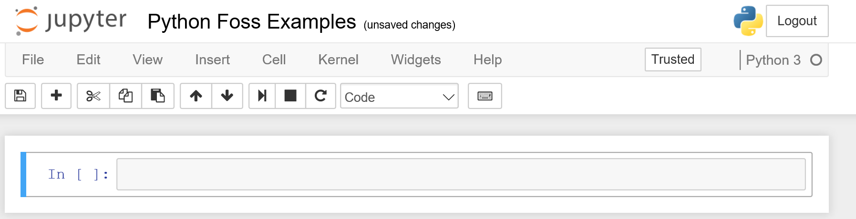

Slide 82
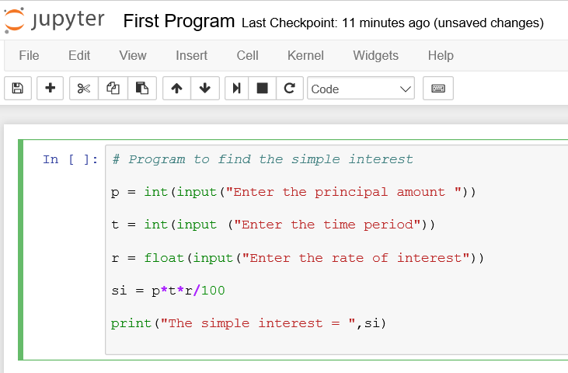

Slide 83
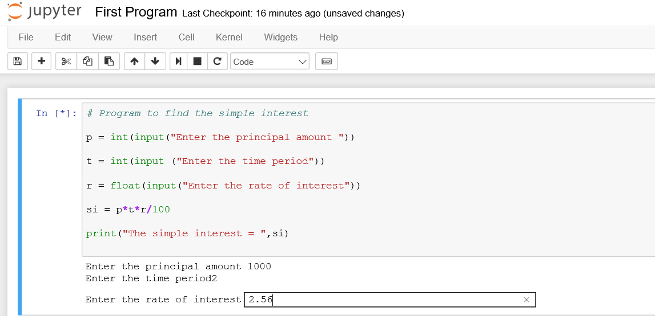

Slide 84
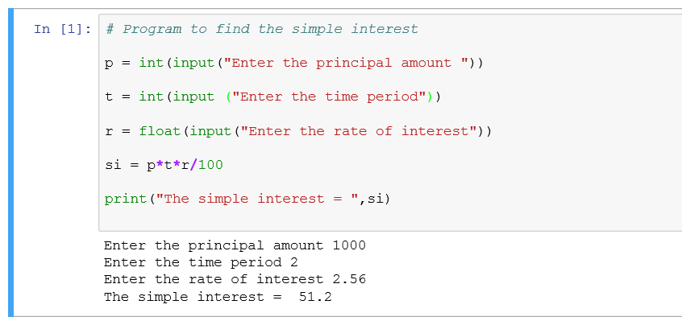

Slide 85
Data Types in Python
Floating Point Numbers | 1.2 | Immutable
Integer Numbers | 2 | Immutable
Complex Numbers | 1+2j | Immutable
Strings | “context” | Immutable
Lists | a = [1, 2.2, 'python'] | Mutable
Tuples | t = (5,'program', 1+3j) | Immutable
Dictionaries | d = {1:'value','key':2} | Immutable + Mutable

Slide 86
Fundamentals of Python for ML
Hands On

Slide 87
3.Decision Tree Learning

Slide 88
Topics
Decision Tree Learning
Decision Trees
Decision Tree Representation
Appropriate Problems for Decision Tree Learning
Basic Decision Tree Learning Algorithm (ID3)
Advantages and Disadvantages of ID3 based Decision Tree Learning

Slide 89
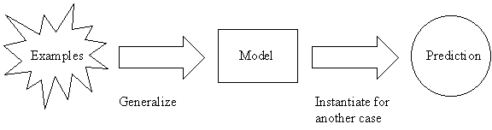
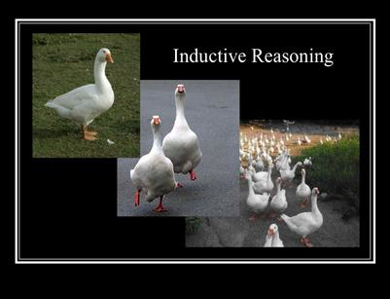
1. Decision Tree Learning
Decision tree learning is one of the most widely used and practical methods for inductive inference. It is a method for approximating discrete-valued target functions, in which the learned function is represented by a decision tree.
Inductive inference is the process of reaching a general conclusion from specific examples.
Is a type of supervised machine learning that is mostly used in classification .

Slide 90
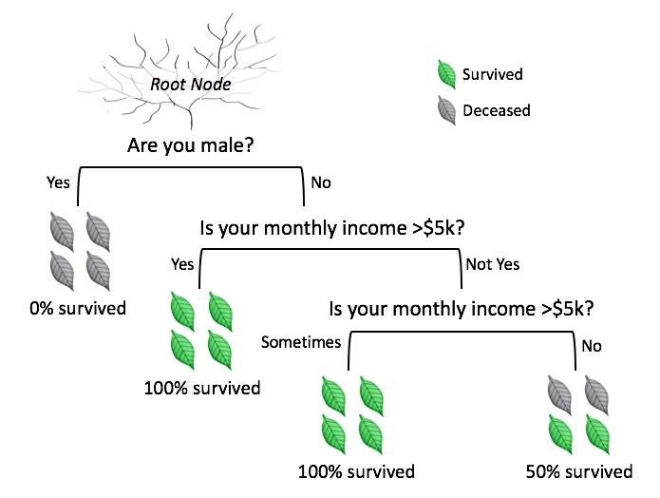
2. Decision Trees
A decision tree is a graphical representation of all possible solutions to decisions based on certain conditions.
A tree structured classifier with two types of nodes :
Decision Nodes and
Leaf Nodes.

Slide 91
3. Decision Tree Representation
Decision trees classify instances by sorting them down the tree from the root to some leaf node, which provides the classiﬁcation of the instance.
In the decision tree representation:
An inner node represents an attribute
Edge / branch represents an attribute value
Leaf represents a class
The paths from root to leaf represent classification rules.
Decision trees represent a disjunction of conjunctions.
Each path from root to a leaf is a conjunction of attribute tests.
The tree itself is a disjunction of these conjunctions.

Slide 92
Training Examples (Data Set)
Day | Outlook | Temp. | Humidity | Wind | Play Tennis
D1 | Sunny | Hot | High | Weak | No
D2 | Sunny | Hot | High | Strong | No
D3 | Overcast | Hot | High | Weak | Yes
D4 | Rain | Mild | High | Weak | Yes
D5 | Rain | Cool | Normal | Weak | Yes
D6 | Rain | Cool | Normal | Strong | No
D7 | Overcast | Cool | Normal | Weak | Yes
D8 | Sunny | Mild | High | Weak | No
D9 | Sunny | Cold | Normal | Weak | Yes
D10 | Rain | Mild | Normal | Strong | Yes
D11 | Sunny | Mild | Normal | Strong | Yes
D12 | Overcast | Mild | High | Strong | Yes
D13 | Overcast | Hot | Normal | Weak | Yes
D14 | Rain | Mild | High | Strong | No

Slide 93
Decision Tree for PlayTennis
Outlook
Sunny
Overcast
Rain
Humidity
Yes
Wind
High
Normal
Strong
Weak
No
Yes
No
Yes

Slide 94
Decision Tree for PlayTennis
Outlook
Outlook
Sunny
Overcast
Rain
Humidity
Each internal node tests an attribute
High
Normal
Each branch corresponds to an
attribute value node
No
Yes
Each leaf node assigns a classification

Slide 95
Decision Tree for Conjunction
Outlook=Sunny ∧ Wind=Weak
Outlook
Sunny
Overcast
Rain
Wind
No
No
Strong
Weak
No
Yes

Slide 96
Decision Tree for Disjunction
Outlook=Sunny ∨ Wind=Weak
Outlook
Sunny
Overcast
Rain
Yes
Wind
Wind
Strong
Weak
Strong
Weak
No
Yes
No
Yes

Slide 97
Decision Tree for XOR
Outlook = Sunny XOR Wind = Weak
Outlook
Sunny
Overcast
Rain
Wind
Wind
Wind
Strong
Weak
Strong
Weak
Strong
Weak
Yes
No
No
Yes
No
Yes

Slide 98
Decision Tree Expressivity
Decision trees represent a disjunction of conjunctions on constraints on the value of attributes:
Outlook
Sunny
Overcast
Rain
Humidity
Yes
Wind
High
Normal
Strong
Weak
No
Yes
No
Yes
(Outlook=Sunny ∧ Humidity=Normal)
∨ (Outlook=Overcast)
∨ (Outlook=Rain ∧ Wind=Weak)

Slide 99
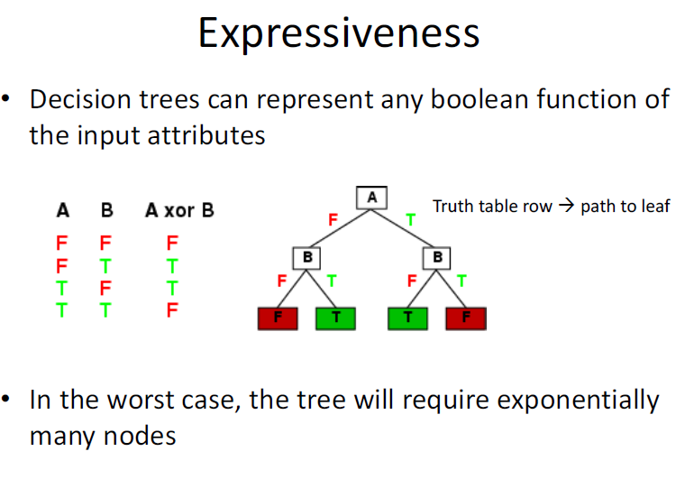

Slide 100
4. Appropriate Problems for Decision Tree Learning
Decision tree learning is generally best suited to problems with the following characteristics:
Instances describable by attribute-value pairs. (Hot, Mild, Cold)
Target function has discrete output values (yes or no).
Disjunctive hypothesis/description may be required.
The training data may contain errors/noisy data.
The training data may contain missing attribute values.
Some examples of problems that ﬁt to these characteristics are:
Medical or equipment diagnosis
Credit risk analysis
Modelling calendar scheduling preferences

Slide 101
5.Basic Decision Tree Learning Algorithm (ID3)
The basic decision tree learning algorithm, ID3, employs a top-down, greedy search through the space of possible decision trees, beginning with the question ”which attribute should be tested at the root of the tree?”.

Slide 102
Day | Outlook | Temperature | Humidity | Wind | PlayTennis
D1 | Sunny | Hot | High | Weak | No
D2 | Sunny | Hot | High | Strong | No
D3 | Overcast | Hot | High | Weak | Yes
D4 | Rain | Mild | High | Weak | Yes
D5 | Rain | Cool | Normal | Weak | Yes
D6 | Rain | Cool | Normal | Strong | No
D7 | Overcast | Cool | Normal | Strong | Yes
D8 | Sunny | Mild | High | Weak | No
D9 | Sunny | Cool | Normal | Weak | Yes
D10 | Rain | Mild | Normal | Weak | Yes
D11 | Sunny | Mild | Normal | Strong | Yes
D12 | Overcast | Mild | High | Strong | Yes
D13 | Overcast | Hot | Normal | Weak | Yes
D14 | Rain | Mild | High | Strong | No

Slide 103
Description of PlayTennis Training Data Examples
No of Data Examples : 14
No of Yes (+) : 9
No of No (-) : 5
Data Example Attributes and their possible Values :
[Outlook ] Values : { Sunny ,Overcast ,Rain }
[Temperature] Values : { Hot , Mild , Cold }
[Humidity] Values : { High, Normal }
[Wind] Values : { Weak, Strong }
Target Attribute :
[PlayTennis] Values : {Yes, No}

Slide 104
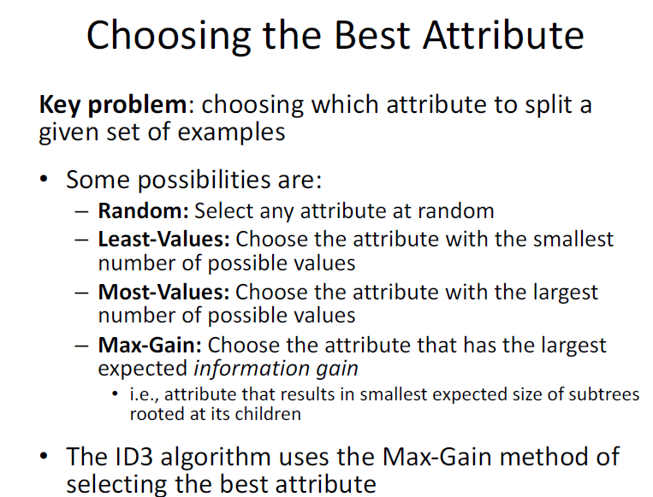

Slide 105
Which attribute is the Best Classifier ?
The central choice in the ID3 algorithm is selecting which attribute to test at each node in the tree.
The attribute must be selected that is most useful for classifying examples .
The statistical property called information gain is the good quantitative measure of the worth of an attribute .
Information Gain measures how well a given attribute separates the training examples according to their target classification.
ID3 uses this information gain measure to select among the candidate attributes at each step while growing the tree.
Information gain uses the notion of entropy, commonly used in information theory
Information gain = expected reduction of entropy

Slide 106
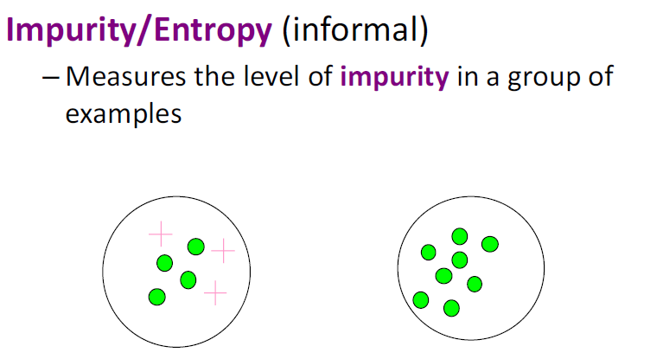

Slide 107
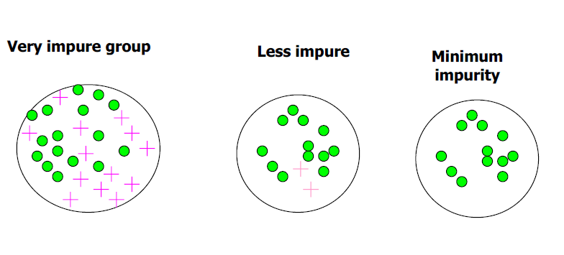

Slide 108
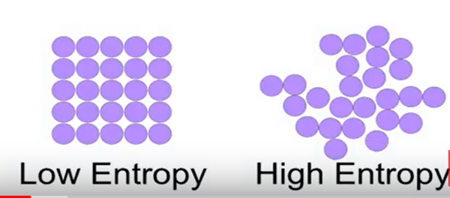
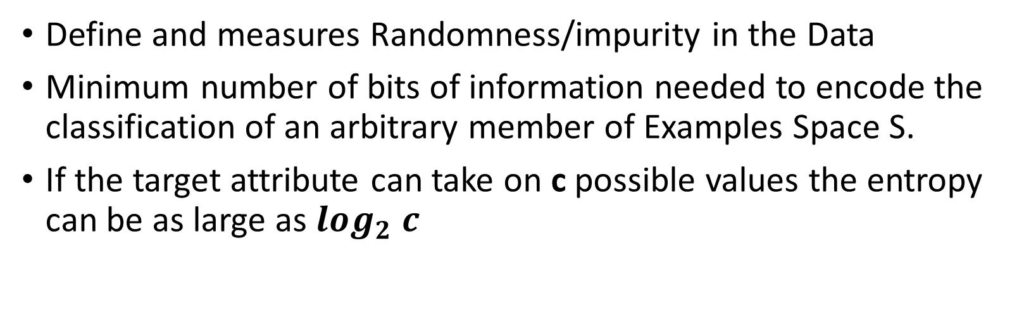
What is Entropy ?
Define and measures Randomness/impurity in the Data
Minimum number of bits of information needed to encode the classification of an arbitrary member of Examples Space S.
If the target attribute can take on c possible values the entropy can be as large as $\log_{2} c$

Slide 109
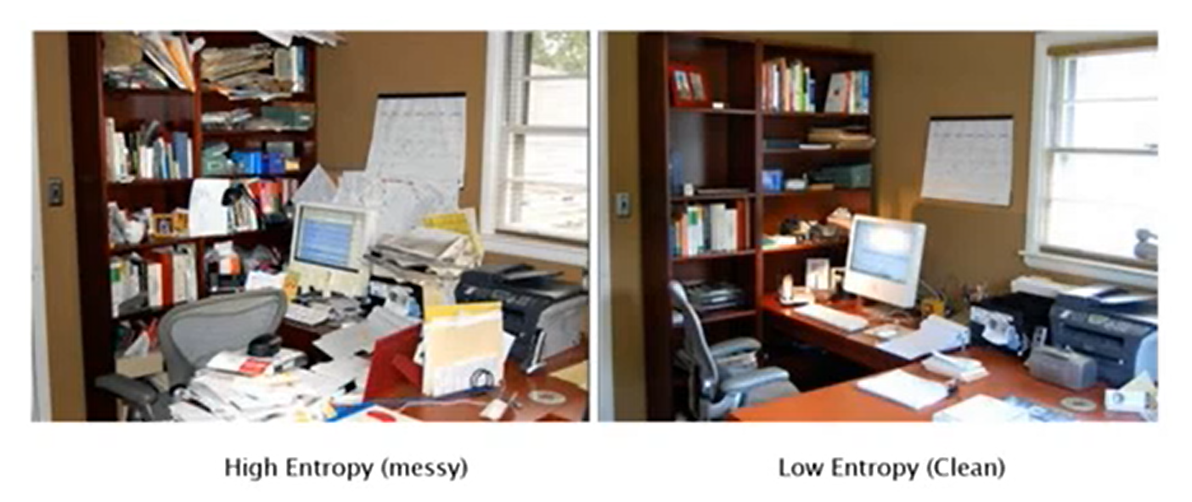

Slide 110
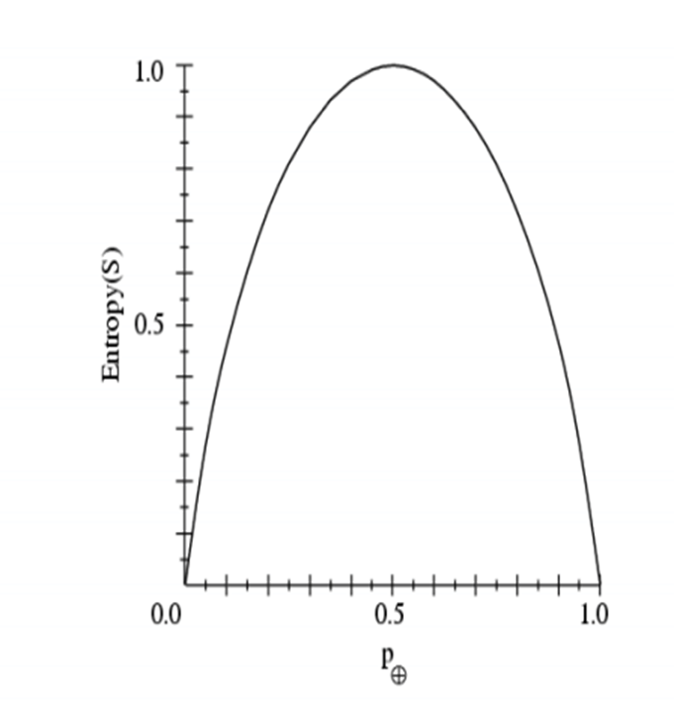
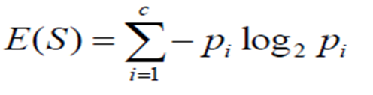
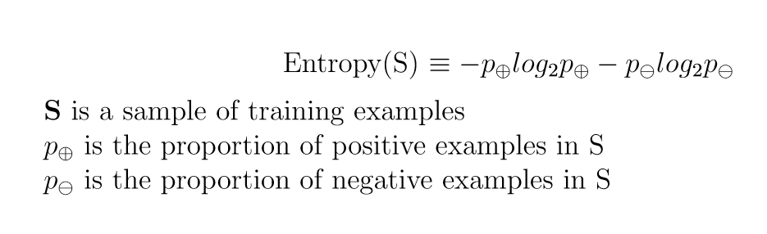
1. Entropy measures Homogeneity of Examples

Slide 111
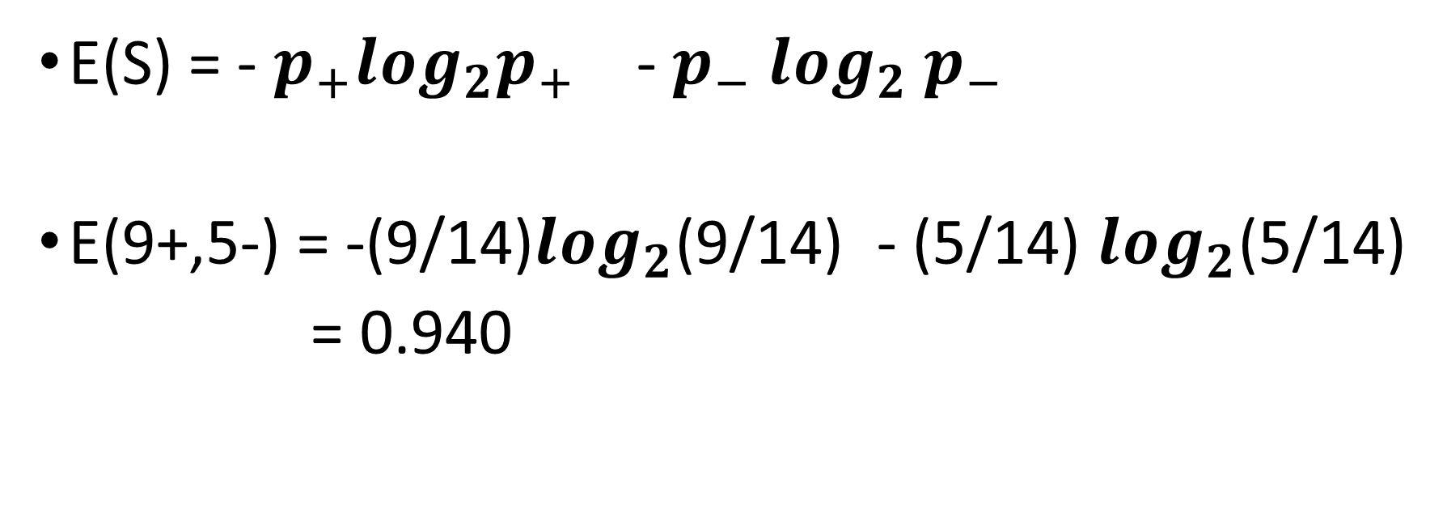
Examples
E(S) = - $p_{+}\log_{2}p_{+}$ - $p_{−}\log_{2}{ p}_{−}$
E(9+,5-) = -(9/14)$\log_{2}$(9/14) - (5/14) $\log_{2}$(5/14)
= 0.940

Slide 112
Entropy (S) ≡ – p₊ log₂ p₊ – p–log₂ p–
Entropy ([14+, 0–]) = – 14/14 log₂ (14/14) – 0 log₂ (0) = 0
Entropy ([9+, 5–]) = – 9/14 log₂ (9/14) – 5/14 log₂ (5/14) = 0.94
Entropy ([7+, 7– ]) = – 7/14 log₂ (7/14) – 7/14 log₂ (7/14)
= 1/2 + 1/2 = 1 [log₂1/2 = – 1]
Notes:
S=[9+, 5-] una collezione di esempi di cui 9 positivi e 5 negativi

Slide 113
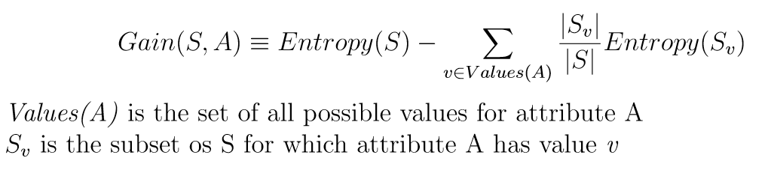
2. Information Gain Measures the expected reduction in Entropy
Information Gain is the expected reduction in entropy caused by partitioning the examples on an attribute. The higher the information gain the more effective the attribute in classifying training data.

Slide 114
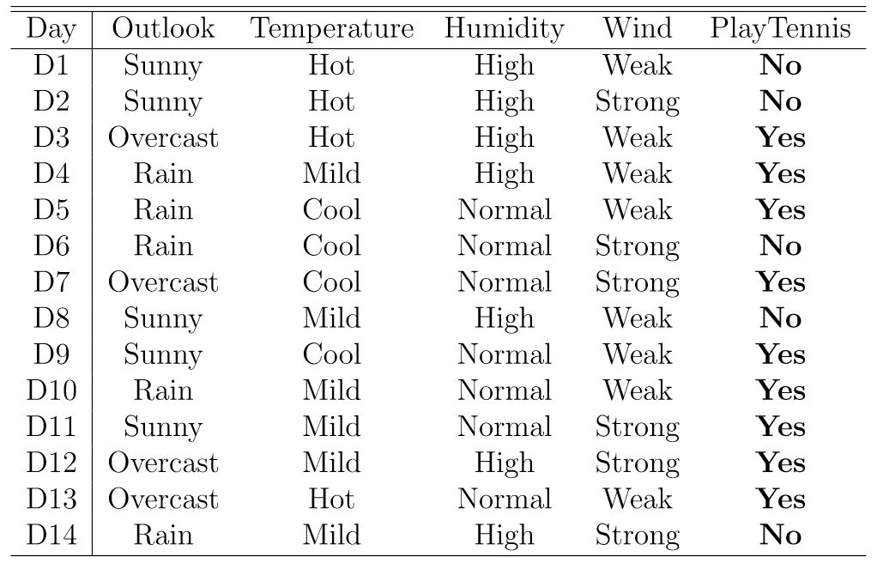
An Illustrative Example
To illustrate the operation of ID3, let’s consider the learning task represented by the below examples.

Slide 115
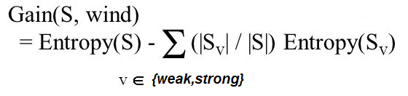
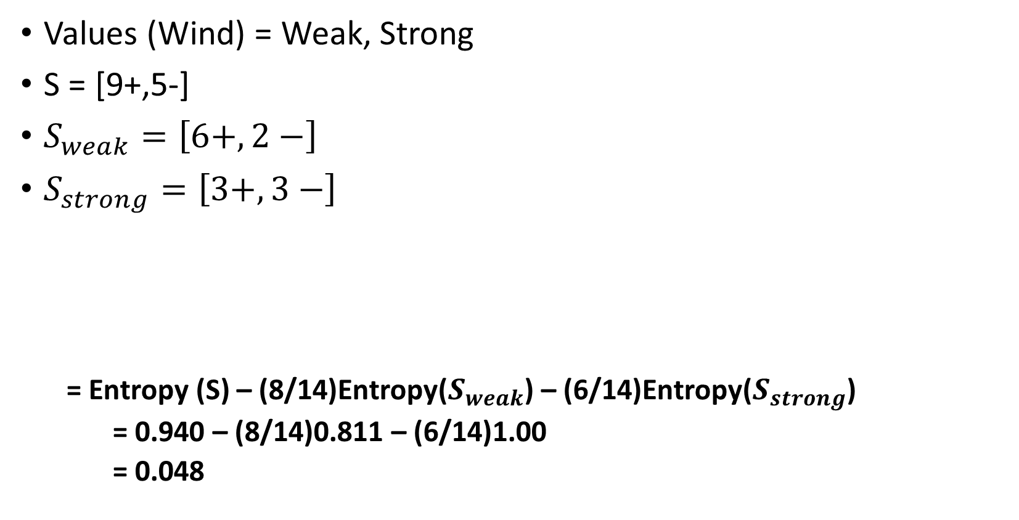
Compute the Gain and identify which attribute is the best as illustrated below
Values (Wind) = Weak, Strong
S = [9+,5-]
$S_{weak}=\left[6+, 2−\right]$
$S_{strong}=\left[3+,3−\right]$
= Entropy (S) – (8/14)Entropy($S_{weak}$) – (6/14)Entropy($S_{strong}$)
= 0.940 – (8/14)0.811 – (6/14)1.00
= 0.048

Slide 116
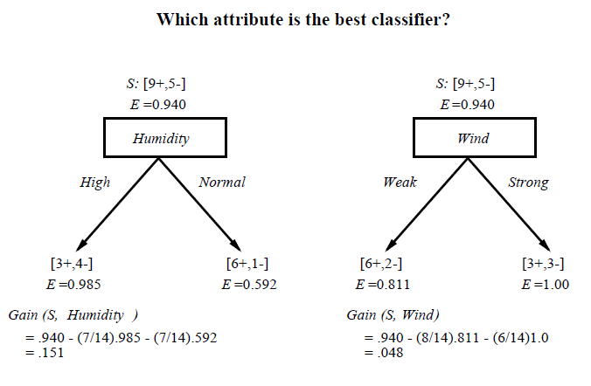

Slide 117
Which attribute to test at the root?
Gain(S, Outlook) = 0.246
Gain(S, Humidity) = 0.151
Gain(S, Wind) = 0.048
Gain(S, Temperature) = 0.029
Outlook provides the best prediction for the target
Lets grow the tree:
add to the tree a successor for each possible value of Outlook
partition the training samples according to the value of Outlook

Slide 118
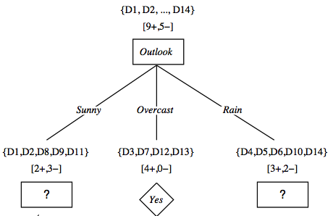
After first step

Slide 119
Second step
Ssunny = {D1,D2,D8,D9,D11}
Working on Outlook=Sunny node:
Gain(S_{Sunny}, Humidity) = 0.970 − 3/5 × 0.0 − 2/5 × 0.0 = 0.970
Gain(S_{Sunny}, Wind) = 0.970 − 2/5 × 1.0 − 3.5 × 0.918 = 0 .019
Gain(S_{Sunny}, Temp.) = 0.970 − 2/5 × 0.0 − 2/5 × 1.0 − 1/5 × 0.0 = 0.570
Humidity provides the best prediction for the target
Lets grow the tree:
add to the tree a successor for each possible value of Humidity
partition the training samples according to the value of Humidity

Slide 120

Second and third steps

Slide 121

Which Tree Should We Output?
ID3 performs heuristic search through space of decision trees
It stops at smallest acceptable tree. Why?

Slide 122
Algorithm : ID3(Training Example, Target Attributes, Attributes)
Create Root node
If all X's are +, return Root with class +
If all X's are –, return Root with class –
If Attrs is empty return Root with class most common value of T in X
else
A ← best attribute; decision attribute for Root ← A
For each possible value v_{i} of A:
- add a new branch below Root, for test A = v_{i}
- X_{i} ← subset of X with A = v_{i}
- If X_{i} is empty then add a new leaf with class the most common value of T in X
else add the subtree generated by ID3(X_{i}, T, Attrs − {A})
return Root

Slide 123


Slide 124
6. Advantages and Disadvantages
Advantages :
Computationally Inexpensive
Handles both numerical and categorical attributes
Outputs are easy to interpret
Works well with both linear and nonlinear data
Sensitive to small variations in the training data
Robust with redundant and correlated data
Disadvantages :
Overfitting
Too many Layers
Lack of training Data
Biased Data in training set
Multicollinearity among variables

Slide 125


Slide 126

Example : Give decision trees to represent the following Boolean functions:

Slide 127


Slide 128


Slide 129


Slide 130


Slide 131

2. Consider the following set of training examples:

Slide 132
A) What is the entropy of this collection of training examples with respect to the target function classification?
The entropy of this collection of training examples with respect to the target function classification is E(S) = 1
because it contains equal numbers of positive and negative examples.

Slide 133
B) What is the information gain of feature A2 relative to these training examples?
The information gain of feature A2 relative to these training examples G(S,A2) = E(S) - ∑|SA2| / |S| * E(S) = 1 – ( 4/8 * 1 + 4/8 * 1) = 0

Slide 134
C) What is the best feature relative to these training examples, using Gain Ratio?
The best feature relative to these training examples is the feature with the maximum information gain, and in this example any feature can selected because the gain of all features are the same.

Slide 135
4.Machine Learning Lab Programs using Python
https://github.com/profthyagu

Slide 136
Lab Programs
Decision tree based ID3 algorithm
Backpropagation algorithm to build ANN
Naïve Bayesian classifier for a sample training data set stored as a .CSV file
Naïve Bayesian classifier to cluster the set of documents
Bayesian Network for Medical Data Set
EM Algorithm + K Means Algorithm for a set of data stored in.csv file
K NN Algorithm for iris data
Locally Weighted Regression Algorithm
FIND-S algorithm for a given set of training data examples stored in a .CSV file.
Candidate-Elimination algorithm for a given set of training data examples stored in a .CSV file

Slide 137
Lab Program 1:
Write a program to demonstrate the working of the decision tree based ID3 algorithm. Use an appropriate data set for building the decision tree and apply this knowledge to classify a new sample.

Slide 139
Source Code
https://github.com/profthyagu

Slide 140
Lab Program 2
Build an Artificial Neural Network by implementing the Backpropagation algorithm and test the same using appropriate data sets.

Slide 141
Artificial neural networks(ANN/NN)
An ANN is a computational model based on the structure and functions of biological neural networks.
An ANN can learn from observing data sets.
ANN takes data samples rather than entire data sets to arrive at solutions, which saves both time and money.

Slide 142

Artificial neural networks
ANNs have three layers that are interconnected.
The first layer consists of input neurons. These neurons send data on to the second layer (Hidden) , which in turn sends the data to the third layer (Output).

Slide 143
Perceptrons
Perceptrons are single-layer feedforward networks
Each output unit is independent of the others
Can assume a single output unit
Activation of the output unit is calculated by:
O = Step₀( W_{j} x_{j} )
where x_{j} is the activation of input unit j, and we assume an additional weight and input to represent the threshold
j

Slide 144

Perceptrons
A Perceptron is a type of artificial neuron which takes in several binary inputs x1, x2, … , xn and produces a single binary output.
In order to compute an output, here’s what you could do (O = Output):
a) Sum up the inputs. O = x1 + x2 + x3
b) Apply a linear mathematical operation to the inputs. O = (x1 * x2) + x3
Note : Thr approach (b) can have its output as O = x3, if x1 or x2 or both are equal to zero. If only one of them is equal to 0, this can lead to a loss of information as the input value gets multiplied by 0.
The simple approach (a), is partially correct and what we can do to make it fully correct.
Approach (a) sure takes into account all the inputs without one being immediately affected by the other. However, it does not take in the relative importance of the inputs.

Slide 145
What does weight mean in terms of neural networks?
Consider a simple example where you want to make a perceptron for predicting whether it will rain today or not. You have a binary output as O, which can take values of 0 or 1 and inputs x1 and x2.
Let x1 be 1 if the weather is humid today, 0 if the opposite.
Let x2 be 1 if you are wearing a red shirt today and 0 if not.
We can see here that wearing a red shirt has almost no correlation with the possibility of rainfall. So, a possible output function can be: O = x1 + 0.1 * x2
Here’s what the factor 0.1 does. If x2 is 0, 0.1*x2 is still 0, but if x2 is 1, 0.1*x2 will be 0.1, not 1.
It basically brings down the importance of the input x2 from 1 to 0.1, and hence, it is called the ‘weight’ of the input x2.
Consider x2 to be 1 for now. O will still be (0 + 0.1) = 0.1 or (1 + 0.1) = 1.1, i.e. not a binary value.
In order to make it one, what we can do is use a ‘threshold’ for the total value of O.
We can say, like, O is 1 if (x1 + 0.1 * x2) > 1 and O = 0 if (x1 + 0.1 * x2) < 1. We have thus solved our problem.

Slide 146



What does weight mean in terms of neural networks?
In general,
And now making some final notational simplifications, we say
Where w = [ w1 w2 w3 …. wn]T, x = [x1 x2 x3 …. xn] and b = -(threshold)
b is commonly known as bias.
Note: ‘T’ is the transpose operation. And w.x is matrix multiplication.

Slide 147


Slide 148
Multi-Layer Perceptron
One or more hidden layers
Sigmoid activations functions
Output layer
2nd hidden
layer
1st hidden
layer
Input data

Slide 149
MULTILAYER NETWORKS AND THE BACKPROPAGATION ALGORITHM
Single perceptron's can only express linear decision surfaces.
In contrast, the kind of multilayer networks learned by the BACKPROPACATION algorithm are capable of expressing a rich variety of nonlinear decision surfaces.
For example, a typical multilayer network and decision surface is depicted in Figure
Here the speech recognition task involves distinguishing among 10 possible vowels, all spoken in the context of "h-d" (i.e., "hid," "had,“ "head," "hood," etc.).

Slide 150

An example
This network was trained to recognize 1 of 10 vowel sounds occurring in the context “h d” (e.g. “head”, “hid”).
The inputs have been obtained from a spectral analysis of sound.
The 10 network outputs correspond to the 10 possible vowel sounds. The net- work prediction is the output whose value is the highest.

Slide 151

An example
This plot illustrates the highly non-linear decision surface represented by the learned network.
Points shown on the plot are test examples distinct from the examples used to train the network.

Slide 152



Sigmoid Function
Sigmoids essentially bring the data within a 0 to 1 range on a smooth curve.
X X X X X X X X X X X X X X X X X X X X X X X X O X X X O O X X X X X X X O X X O O OO X X X X XO O X X X X O O X X X X X X X X X X X X X X X X X X X X X
X X X X X X X X X X O O O O X X O O O O O O O O O O O O
Thinking=Sigmoid, Acting=Threshold, in general

Slide 153

Sigmoid Threshold Unit

Slide 154

Error Gradient for the Sigmoid Unit

Slide 155

Back Propagation Algorithm for Feed Forward networks

Slide 156

The Backpropagation Algorithm for a feed-forward 2-layer network of sigmoid units, the stochastic version

Slide 157
Source Code
https://github.com/profthyagu

Slide 158
LabProgram 3
Write a program to implement the naïve Bayesian classifier for a sample training data set stored as a .CSV file. Compute the accuracy of the classifier, considering few test data sets.

Slide 159

Use cases

Slide 160

Use cases

Slide 161

Conditional Probability
Definition. The conditional probability of an event A given that an event B has occurred is written: P(A|B) and is calculated using:
P(A|B)= P(A∩B) / P(B) as long as P(B) > 0.
Example :
P(A) = 4/52
P(B) = 4/51
P(A and B) = 4/52*4/51= 0.006

Slide 162


Bayes Theorem
Bayes' theorem is stated mathematically as the following equation

Slide 163

Bayes Theorem
Bayes' theorem is stated mathematically as the following equation

Slide 164

Alternative form

Slide 165

Example of Bayes Theorem
P(A ∣ B) = P(B ∣ A)P(A) / P(B)
Consider a drug test that is 99 percent sensitive(the true positive rate) and 99 percent specific (the true negative rate). If half a percent (0.5 percent) of people use a drug, what is the probability a random person with a positive test actually is a user?

Slide 166



Naive Bayes classifier /Bayes Rule
Using Bayes' theorem, the conditional probability can be decomposed as
In practice, there is interest only in the numerator of that fraction, because the denominator does not depend on C
The corresponding classifier, a Bayes classifier, is the function that assigns a class label for some k as follows:

Slide 167


Naive Bayes classifier
The Naive Bayes Classifier technique is based on the so-called Bayesian theorem and is particularly suited when the dimensionality of the inputs is high. Despite its simplicity, Naive Bayes can often outperform more sophisticated classification methods.

Slide 168

Example :Since there is a total of 60 objects, 40 of which are GREEN and 20 RED, our prior probabilities for class membership are:

Slide 169



Example :Having formulated our prior probability, we are now ready to classify a new object (WHITE circle).
From the illustration above, it is clear that Likelihood of X given GREEN is smaller than Likelihood of X given RED, since the circle encompasses 1 GREEN object and 3 RED ones. Thus:

Slide 170

Example :
In the Bayesian analysis, the final classification is produced by combining both sources of information, i.e., the prior and the likelihood, to form a posterior probability using the so-called Bayes' rule (named after Rev. Thomas Bayes 1702-1761).

Slide 171
Event Models
The assumptions on distributions of features are called the event model of the Naive Bayes classifier.
For discrete features like the ones encountered in document classification (include spam filtering), multinomial and Bernoulli distributions are popular.
For Continuous feature , Gaussian naive Bayes distributions is popular.

Slide 172


1. Gaussian naive Bayes
When dealing with continuous data, a typical assumption is that the continuous values associated with each class are distributed according to a Gaussian distribution.
Then, the probability distribution of v given a class
can be computed by plugging V into the equation for a Normal distribution parameterized by

Slide 173

2. Multinomial naive Bayes
Its is used when we have discrete data (e.g. movie ratings ranging 1 and 5 as each rating will have certain frequency to represent). In text learning we have the count of each word to predict the class or label

Slide 174

2. Multinomial naive Bayes
Its is used when we have discrete data (e.g. movie ratings ranging 1 and 5 as each rating will have certain frequency to represent). In text learning we have the count of each word to predict the class or label.
The Multinomial Naive Bayes's conditional distribution is:

Slide 175


Slide 176

3. Bernoulli naive Bayes
It assumes that all our features are binary such that they take only two values. Means 0s can represent “word does not occur in the document” and 1s as "word occurs in the document" .

Slide 177
Example 1
Import
import pandas as pd
import numpy as np

Slide 178

Create Data

Slide 179


Slide 180


Slide 181


Slide 182


Slide 183
marginal probability marginal probability is probably one of the most confusing parts of Bayesian approaches.

Slide 184


Slide 185


Slide 186


Slide 187


Slide 188


Slide 189


Slide 190


Slide 191
Source Code
https://github.com/profthyagu

Slide 192
Lab Program 4
Assuming a set of documents that need to be classified, use the naïve Bayesian Classifier model to perform this task. Built-in Libraries can be used to write the program. Calculate the accuracy, precision, and recall for your data set.

Slide 193
Learning to Classify Text – Algorithm
S1: LEARN_NAIVE_BAYES_TEXT (Examples, V)
S2: CLASSIFY_NAIVE_BAYES_TEXT (Doc)
Examples is a set of text documents along with their target values. V is the set of all possible target values. This function learns the probability terms P(wk I vj), describing the probability that a randomly drawn word from a document in class vj will be the English word wk. It also learns the class prior probabilities P(vj).

Slide 194


S1: LEARN_NAIVE_BAYES_TEXT (Examples, V)
[ V: Class , W: Word, doc : Documents]
1. collect all words and other tokens that occur in Examples
Vocabulary ← all distinct words and other tokens in Examples
2. calculate the required P(v_{j}) and P(w_{k} | v_{j}) probability terms
For each target value v_{j} in V do
docs_{j} ← subset of Examples for which the target value is v_{j}
Text_{j} ← a single document created by concatenating all members of docs_{j}
n ← total number of words in Text_{j} (counting duplicate words multiple times)
for each word w_{k} in Vocabulary
n_{k} ← number of times word w_{k} occurs in Text_{j}

Slide 195

S2:CLASSIFY_NAIVE_BAYES_TEXT (Doc)
positions ← all word positions in Doc that contain tokens found in Vocabulary
Return v_{NB} where

Slide 196
Twenty NewsGroups
Given 1000 training documents from each group Learn to classify new documents according to which newsgroup it came from
Naive Bayes: 89% classification accuracy
comp.graphics comp.os.ms-windows.misc comp.sys.ibm.pc.hardware comp.sys.mac.hardware comp.windows.x | misc.forsale rec.autos rec.motorcycles rec.sport.baseball rec.sport.hockey | alt.atheism soc.religion.christian talk.religion.misc talk.politics.mideast talk.politics.misc talk.politics.guns | sci.space sci.crypt sci.electronics sci.med

Slide 197

Learning Curve for 20 Newsgroups
Accuracy vs. Training set size (1/3 withheld for test)

Slide 198

Example :
In the example, we are given a sentence “ A very close game”, a training set of five sentences (as shown below), and their corresponding category (Sports or Not Sports).
The goal is to build a Naive Bayes classifier that will tell us which category the sentence “ A very close game” belongs to.
Applying a Naive Bayes classifier, thus the strategy would be calculating the probability of both “A very close game is Sports”, as well as it’s Not Sports. The one with the higher probability will be the result.

Slide 199
Step 1: Feature Engineering
word frequencies, i.e., counting the occurrence of every word in the document.
P( a very close game) = P(a) X P(very) X P(close) X P(game)
P(a very close game | Sports) = P(a|Sports) X P(Very|Sports) X P(close|Sports) X P(game|Sports)
P(a very close game | Not Sports) = P(a | Not Sports) x P(very | Not Sports) x P(close | Not Sports) x P(game | Not Sports)

Slide 200

Step 2: Calculating the probabilities
Here , the word “close” does not exist in the category Sports, thus P(close |Sports) = 0, leading to P(a very close game | Sports)=0.
Given an observation x = (x1, …, xd) from a multinomial distribution with N trials and parameter vector θ = (θ1, …, θd), a "smoothed" version of the data gives the estimator.
where the pseudo count α > 0 is the smoothing parameter (α = 0 corresponds to no smoothing)

Slide 201


As seen from the results shown below, P(a very close game | Sports) gives a higher probability, suggesting that the sentence belongs to the Sports category.

Slide 202


Slide 204


Confusion Matrix
A confusion matrix is a summary of prediction results on a classification problem.
The number of correct and incorrect predictions are summarized with count values and broken down by each class.
The confusion matrix shows the ways in which your classification model is confused when it makes predictions.

Slide 205
Source Code
GITHUB LINK: https://github.com/profthyagu

Slide 206
Lab Program5
Write a program to construct a Bayesian network considering medical data. Use this model to demonstrate the diagnosis of heart patients using standard Heart Disease Data Set. You can use Python ML library API.

Slide 207
Bayesian Network (BAYESIAN BELIEF NETWORKS)
Bayesian Belief networks describe conditional independence among subsets of variables
→ allows combining prior knowledge about (in)dependencies among variables with observed training data
(also called Bayes Nets)

Slide 208
Conditional Independence
Definition: X is conditionally independent of Y given Z if the probability distribution governing X is independent of the value of Y given the value of Z; that is, if
(∀x_{i}, y_{j}, z_{k}) P(X= x_{i}|Y= y_{j}, Z= z_{k}) = P(X= x_{i}|Z= z_{k})
more compactly, we write
P(X|Y, Z) = P(X|Z)
Example: Thunder is conditionally independent of Rain, given Lightning
P(Thunder|Rain, Lightning) = P(Thunder|Lightning)
Naive Bayes uses cond. indep. to justify
P(X, Y|Z) = P(X|Y, Z) P(Y|Z) = P(X|Z) P(Y|Z)

Slide 209


Bayesian Belief Network (1/2)
Network represents a set of conditional independence assertions:
Each node is asserted to be conditionally independent of its non descendants, given its immediate predecessors.
Directed acyclic graph

Slide 210

Bayesian Belief Network (2/2)
Represents joint probability distribution over all variables
e.g., P(Storm, BusTourGroup, . . . , ForestFire)
in general,
where Parents(Y_{i}) denotes immediate predecessors of Y_{i} in graph
so, joint distribution is fully defined by graph, plus the P(y_{i}|Parents(Y_{i}))

Slide 211


Slide 212


Slide 213
Source Code
https://github.com/profthyagu

Slide 214
Lab Program 6
Apply EM algorithm to cluster a set of data stored in a .CSV file. Use the same data set for clustering using k-Means algorithm. Compare the results of these two algorithms and comment on the quality of clustering. You can add Python ML library classes/API in the program.

Slide 215

Generating Data from Mixture of k Gaussians
Each instance x generated by
1. Choosing one of the k Gaussians with uniform probability
2. Generating an instance at random according to that Gaussian

Slide 216

Gaussian Distribution

Slide 217


Gaussian Mixtures

Slide 218








GMM : Example

Slide 219
Expectation Maximization (EM) Algorithm
When to use:
Filling in missing data in samples
Discovering the value of latent variables
Estimating the parameters of HMMs
Estimating parameters of finite mixtures
Unsupervised learning of clusters
Semi-supervised classification and clustering

Slide 220
Expectation Maximization (EM) Algorithm
EM is typically used to compute maximum likelihood estimates given incomplete samples.
The EM algorithm estimates the parameters of a model iteratively.
Starting from some initial guess, each iteration consists of
an E step (Expectation step)
an M step (Maximization step)

Slide 221


EM Algorithm
Given:
Instances from X generated by mixture of k Gaussian distributions
Unknown means <μ₁,…,μ_{k} > of the k Gaussians
Don’t know which instance x_{i} was generated by which Gaussian
Determine:
Maximum likelihood estimates of <μ₁,…,μ_{k} >
EM Algorithm:
Pick random initial h = <μ₁, μ₂> then iterate
E step: Calculate the expected value E[z_{ij}] of each hidden variable z_{ij}, assuming the current hypothesis
h = <μ₁, μ₂> holds.
M step: Calculate a new maximum likelihood hypothesis h' = <μ'₁, μ'₂>, assuming the value taken on by each hidden variable z_{ij} is its expected value E[z_{ij}] calculated above. Replace h = <μ₁, μ₂> by h' = <μ'₁, μ'₂>.

Slide 222


Slide 223


Slide 224


Slide 225


Slide 226


Slide 227


Slide 228

GMM : Example2

Slide 229


GMM : Example2

Slide 230


GMM : Example2

Slide 231


GMM : Example2

Slide 232


Slide 233

K Means Algorithm
1. The sample space is initially partitioned into K clusters and the observations are randomly assigned to the clusters.
2. For each sample:
Calculate the distance from the observation to the centroid of the cluster.
IF the sample is closest to its own cluster THEN leave it ELSE select another cluster.
3. Repeat steps 1 and 2 untill no observations are moved from one cluster to another

Slide 234


Slide 235


Slide 236


Slide 237


Slide 238

Examples of K Means

Slide 239

How the K-Mean Clustering algorithm works?

Slide 240


Slide 241

K-means clustering example

Slide 242
Source Code

Slide 243
Lab Program 7
Write a program to implement k-Nearest Neighbour algorithm to classify the iris data set. Print both correct and wrong predictions. Python ML library classes can be used for this problem.

Slide 244

K-Nearest-Neighbor Algorithm
Principle: points (documents) that are close in the space belong to the same class

Slide 245
Definition of Nearest Neighbor
K-nearest neighbors of a record x are data points that have the k smallest distance to x

Slide 246
Nearest Neighbor Classification
Compute distance between two points:
Euclidean distance

Slide 247

Distance Metrics
Notes:
Minkowsky = l-norm

Slide 248
Selection of Distance Metrics
You can choose the best distance metric based on the properties of your data. If you are unsure, you can experiment with different distance metrics and different values of K together and see which mix results in the most accurate models.
Euclidean is a good distance measure to use if the input variables are similar in type (e.g. all measured widths and heights).
Manhattan distance is a good measure to use if the input variables are not similar in type (such as age, gender, height, etc.).

Slide 249
Nearest Neighbor Classification…
Choosing the value of k:
If k is too small, sensitive to noise points
If k is too large, neighborhood may include points from other classes

Slide 250

Example: Consider the following data concerning credit default. Age and Loan are two numerical variables (predictors) and Default is the target.

Slide 251
Example: We can now use the training set to classify an unknown case (Age=48 and Loan=$142,000) using Euclidean distance. If K=1 then the nearest neighbor is the last case in the training set with Default=Y.
D = Sqrt[(48-33)^2 + (142000-150000)^2] = 8000.01 >> Default=Y

Slide 252

With K=3, there are two Default=Y and one Default=N out of three closest neighbors. The prediction for the unknown case is again Default=Y.

Slide 253
Source Code
https://github.com/profthyagu

Slide 254
Lab Program 8
Implement the non-parametric Locally Weighted Regression (LOWESS) algorithm in order to fit data points. Select appropriate data set for your experiment and draw graphs.

Slide 255


Regression
Regression is a technique from statistics that is used to predict values of a desired target quantity when the target quantity is continuous .
In regression, we seek to identify (or estimate) a continuous variable y associated with a given input vector x.
y is called the dependent variable.
x is called the independent variable.

Slide 256





Slide 257

What lines "really" best fit each case?

Slide 258


Loess/Lowess Regression
Loess regression is a nonparametric technique that uses local weighted regression to fit a smooth curve through points in a scatter plot.

Slide 259


Lowess Algorithm
Locally weighted regression is a very powerful non-parametric model used in statistical learning .Given a dataset X, y, we attempt to find a model parameter β(x) that minimizes residual sum of weighted squared errors. The weights are given by a kernel function(k or w) which can be chosen arbitrarily .
Algorithm
Read the Given data Sample to X and the curve (linear or non linear) to Y
Set the value for Smoothening parameter or Free parameter say τ
Set the bias /Point of interest set X0 which is a subset of X
Determine the weight matrix using :
Determine the value of model term parameter β using :
Prediction = x0*β

Slide 260
Source Code
https://github.com/profthyagu

Slide 261
Lab Program 9
Implement and demonstrate the FIND-S algorithm for finding the most specific hypothesis based on a given set of training data samples. Read the training data from a .CSV file.
Day | Sky | AirTemp | Humidity | Wind | Water | Forecast | EnjoySport
1 | Sunny | Warm | Normal | Strong | Warm | Same | Yes
2 | Sunny | Warm | High | Strong | Warm | Same | Yes
3 | Rainy | Cold | High | Strong | Warm | Change | No
4 | Sunny | Warm | High | Strong | Cool | Change | Yes

Slide 262
What is a Concept?
A Concept is a subset of objects or events defined over a larger set [Example: The concept of a bird is the subset of all objects (i.e., the set of all things or all animals) that belong to the category of bird.]
Alternatively, a concept is a boolean-valued function defined over this larger set [Example: a function defined over all animals whose value is true for birds and false for every other animal].
Things
Birds
Animals
Cars

Slide 263
What is Concept-Learning?
Given a set of examples labeled as members or non-members of a concept, concept-learning consists of automatically inferring the general definition of this concept.
In other words, concept-learning consists of approximating a boolean-valued function from training examples of its input and output.

Slide 264
A CONCEPT LEARNING TASK
Consider the example task of learning the target concept "days on which my friend Aldo enjoys his favorite water sport.“
Table describes a set of example days, each represented by a set of attributes.
The attribute EnjoySport indicates whether or not Aldo enjoys his favorite water sport on this day.
The task is to learn to predict the value of EnjoySport for an arbitrary day, based on the values of its other attributes.
Database:
Day | Sky | AirTemp | Humidity | Wind | Water | Forecast | EnjoySport
1 | Sunny | Warm | Normal | Strong | Warm | Same | Yes
2 | Sunny | Warm | High | Strong | Warm | Same | Yes
3 | Rainy | Cold | High | Strong | Warm | Change | No
4 | Sunny | Warm | High | Strong | Cool | Change | YEs

Slide 265
Example of a Concept Learning
Concept: Good Days for Water Sports (values: Yes, No)
Attributes/Features:
Sky (values: Sunny, Cloudy, Rainy)
AirTemp (values: Warm, Cold)
Humidity (values: Normal, High)
Wind (values: Strong, Weak)
Water (Warm, Cool)
Forecast (values: Same, Change)
Example of a Training Point:
<Sunny, Warm, High, Strong, Warm, Same, Yes>
class

Slide 266


Slide 267


Slide 268


Slide 269
Terminology and Notation
Chosen Hypothesis Representation:
Conjunction of constraints on each attribute where:
“?” means “any value is acceptable”
“0” means “no value is acceptable”
Example of a hypothesis: <?, Cold, High, ?, ?, ?> (If the air temperature is cold and the humidity high then it is a good day for water sports)
Goal: To infer the “best” concept-description from the set of all possible hypotheses (“best” means “which best generalizes to all (known or unknown) elements of the instance space”)
The most general hypothesis-that every day is a good day for water sports, positive example-is represented by <?, ?, ?, ?, ?, ?> and
The most specific possible hypothesis-that no day is a positive example-is represented by <0,0,0,0,0,0>

Slide 270
Terminology and Notation
The set of items over which the concept is defined is called the set of instances (denoted by X)
The concept to be learned is called the Target Concept (denoted by c: X--> {0,1})
The set of Training Examples D is a set of instances, x, along with their target concept value c(x).
Members of the concept (instances for which c(x)=1) are called positive examples.
Non members of the concept (instances for which c(x)=0) are called negative examples.
H represents the set of all possible hypotheses. H is determined by the human designer’s choice of a hypothesis representation.
The goal of concept-learning is to find a hypothesis h:X --> {0,1} such that h(x)=c(x) for all x in X.

Slide 271


Slide 272


Slide 273


Slide 274


Slide 275
Algorithm : Find-S, a Maximally Specific Hypothesis
Initialize h to the most specific hypothesis in H
For each positive training instance x
For each attribute constraint a_{i} in h
If the constraint a_{i} in h is satisfied by x then do nothing
else replace a_{i} in h by the next more general constraint that is satisfied by x
Output hypothesis h

Slide 276

Step1: Find S

Slide 277

Step2 : Find S

Slide 278


Step2 : Find S

Slide 279

Iteration 4 and Step 3 : Find S

Slide 280
Hypothesis Space Search by Find-S
Instances
Hypotheses
x₃
specific
h₀
h₁
x₁
h_{2,3}
x₂
x₄
h₄
general
x₁=<Sunny,Warm,Normal,Strong,Warm,Same>+
h₀ = < Ø, Ø, Ø, Ø, Ø, Ø,>
h₁=< Sunny,Warm,Normal,Strong,Warm,Same>
x₂=<Sunny,Warm,High,Strong,Warm,Same> +
h_{2,3}=< Sunny,Warm,?,Strong,Warm,Same>
x₃=<Rainy,Cold,High,Strong,Warm,Change> -
h₄=< Sunny,Warm,?, Strong,?,?>
x₄=<Sunny,Warm,High,Strong,Cool,Change> +

Slide 281
Source Code
https://github.com/profthyagu

Slide 282
Lab Program 10
For a given set of training data examples stored in a .CSV file, implement and demonstrate the Candidate - Elimination algorithm to output a description of the set of all hypotheses consistent with the training examples

Slide 283

Version Spaces

Slide 284
Representing Version Spaces
The general boundary, G, of version space VS_{H,D} is the set of maximally general members.
The specific boundary, S, of version space VS_{H,D} is the set of maximally specific members.
Every member of the version space lies between these boundaries
VS_{H,D} = {h ∈ H| (∃ s ∈ S) (∃ g ∈ G) (g ≥ h ≥ s)
where x ≥ y means x is more general or equal than y

Slide 285


Slide 286
Candidate Elimination Algorithm
The CANDIDATE-ELIMINATION algorithm computes the version space containing all hypotheses from H that are consistent with an observed sequence of training examples.
It begins by initializing the version space to the set of all hypotheses in H; that is, by initializing the G boundary set to contain the most general hypothesis in H
Go ← {(?, ?, ?, ?, ?, ?)}
and initializing the S boundary set to contain the most specific (least general) hypothesis
So ← {(ø, ø, ø, ø, ø, ø)}

Slide 287
2.5 Candidate Elimination Algorithm
G ← maximally general hypotheses in H
S ← maximally specific hypotheses in H
For each training example d=<x,c(x)>
Case 1 : If d is a positive example
Remove from G any hypothesis that is inconsistent with d
For each hypothesis s in S that is not consistent with d
Remove s from S.
Add to S all minimal generalizations h of s such that
h consistent with d
Some member of G is more general than h
Remove from S any hypothesis that is more general than another hypothesis in S
Case 2: If d is a negative example
Remove from S any hypothesis that is inconsistent with d
For each hypothesis g in G that is not consistent with d
remove g from G.
Add to G all minimal specializations h of g such that
h consistent with d
Some member of S is more specific than h
Remove from G any hypothesis that is less general than another hypothesis in G

Slide 288


Slide 289

An Illustrative Example
Figure traces the CANDIDATE-ELIMINATION algorithm applied to the first two training examples from table

Slide 290

Trace1

Slide 291

Trace 2

Slide 292

Trace3

Slide 293

Final Version Space

Slide 294


Slide 295
Source Code
https://github.com/profthyagu

Slide 296
Github Repository
https://github.com/profthyagu

